Slide 1
预训练模型的发展

Slide 2
ELMo
建议的下游任务使用方式
freeze the weights of the biLM and then concatenate the ELMo vector ELMo_{task}^{k} with x_{k} and pass the ELMo enhanced representation [x_{k}; ELMo_{task}^{k} ] into the task RNN
将ELMo向量与词向量拼接输入下游模型

Slide 3
ELMo
We have introduced a general approach for learning high-quality deep context-dependent representations from biLMs, and shown large improvements when applying ELMo to a broad range of NLP tasks
预训练是一种通用的提升效果的手段

Slide 4
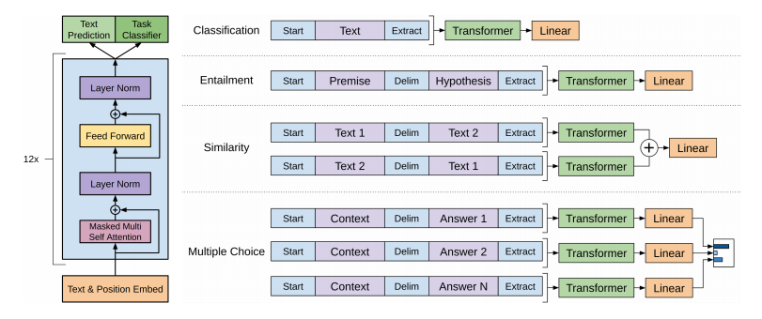
GPT
早于BERT，启用了Transformer作为核心编码器
开始使用特有token连接不同句子

Slide 5

GPT
语言模型采取单向
在语言模型预训练的基础上，增加了有监督任务训练
基本上实锤了Transformer优于LSTM

Slide 6
GPT
Using unsupervised (pre-)training to boost performance on discriminative tasks has long been an important goal of Machine Learning research. Our work suggests that achieving significant performance gains is indeed possible, and offers hints as to what models (Transformers) and data sets (text with long range dependencies) work best with this approach.
明确指出预训练的是有效的，transformer是好用的

Slide 7
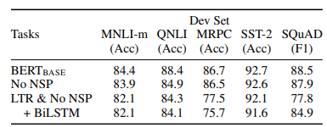
BERT
MASK LM任务
Next Sentence Predict任务
证明了MLM预训练强于单向（LTR left to right）

Slide 8
BERT
Recent empirical improvements due to transfer learning with language models have demonstrated that rich, unsupervised pre-training is an integral part of many language understanding systems.
Our major contribution is further generalizing these findings to deep bidirectional architectures, allowing the same pre-trained model to successfully tackle a broad set of NLP task
从此以后，预训练就是起跑线

Slide 9
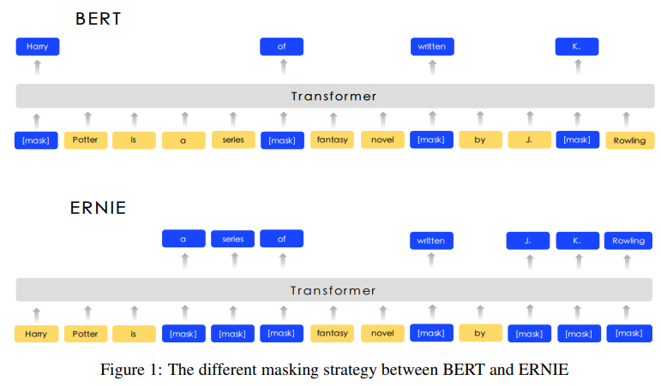
Ernie-baidu
Mask随机token -> Mask实体或词组

Slide 10
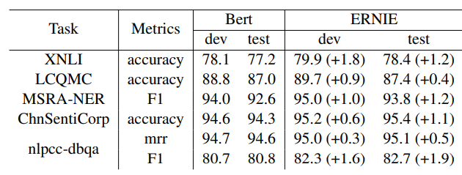
Ernie-baidu
在一系列中文数据集上效果强于BERT

Slide 11
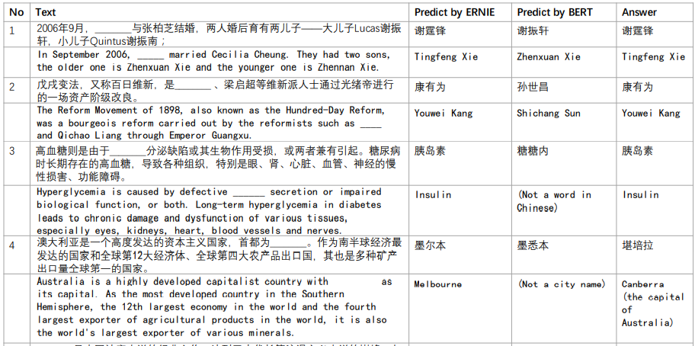
Ernie-baidu
以完形填空的方式完成知识问答

Slide 12
Ernie-baidu
We introduce a new learning processing of language model which masking the units such as phrases and entities in order to implicitly learn both syntactic and semantic information from these units
这种做法在本质上相当于在预训练中加入了先验知识，可以更好的学习该语言
但是这也意味着对未知语言可能会无法使用该策略

Slide 13
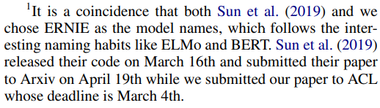
Ernie- Tsinghua
跟百度撞了名字
Baidu: Enhanced Representation through Knowledge Integration
Tsinghua: Enhanced Language Representation with Informative Entities

Slide 14
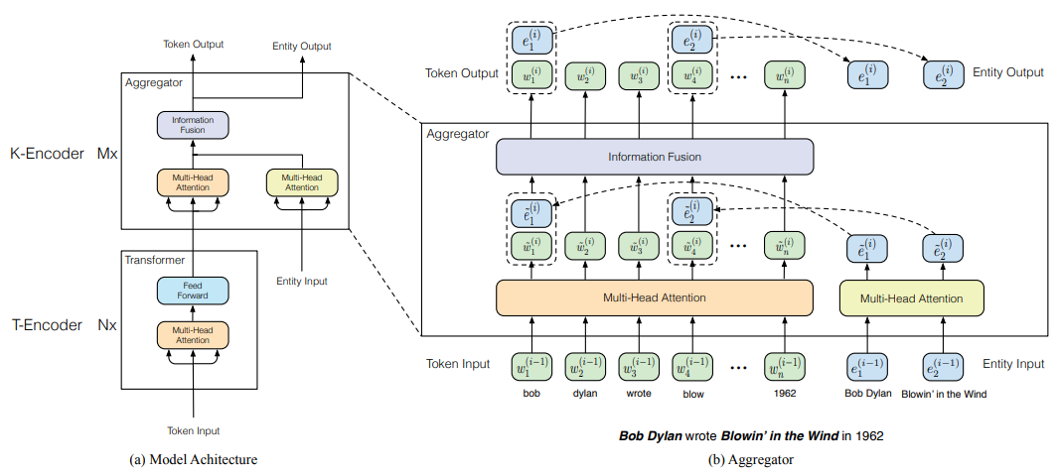
Ernie- Tsinghua
引入知识图谱，将实体信息融合到预训练任务中
使用了自己训练的知识图谱实体Embedding

Slide 15
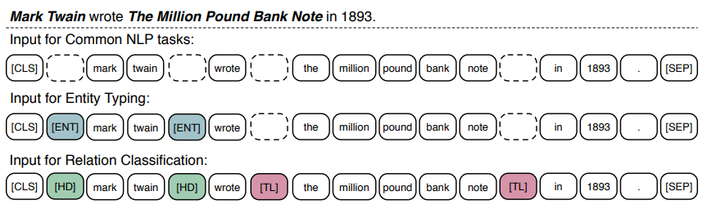
Ernie- Tsinghua
下游fine-tune修改
对于不同实体分类和关系分类引入了两种token来加强模型对实体信息的认知

Slide 16
Ernie- Tsinghua
It demonstrates extra knowledge helps the model make full use of small training data, which is important for most NLP tasks as large-scale annotated data is unavailable.
强调了额外知识的重要性
但是Ernie本身其实缩小了encoder主体模型，还缩短了训练句长，最终并没有很惊艳的效果，只在图谱挖掘相关的任务上有提升。而且这种方法对额外知识的依赖很难满足。
可以看做他们对自己图谱工作的一种延伸

Slide 17

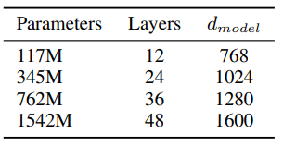
GPT2
Too Dangerous to Release！
继续使用单向语言模型
继续使用transformer结构（小改）
Bigger model，more data
文本生成能力可圈可点

Slide 18


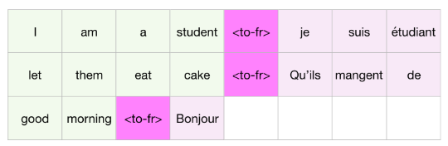
GPT2
强调zero-shot
任何一个任务，可以看做
所有任务可以概括为
以翻译任务为例，希望语言模型输出：
Input
Task
Output

Slide 19
GPT2
The diversity of tasks the model is able to perform in a zero-shot setting suggests that high-capacity models trained to maximize the likelihood of a sufficiently varied text corpus begin to learn how to perform a surprising amount of tasks without the need for explicit supervision
大规模语言模型可以在不做有监督训练的情况下，完成许多任务

Slide 20
UNILM
UNIfied pre-trained Language Model
使用Bert的模型结构，同时进行Mask LM，单向LM，和seq2seq训练
使得预训练后模型可以更好的应用在生成式任务上
如机器翻译和机器摘要等

Slide 21
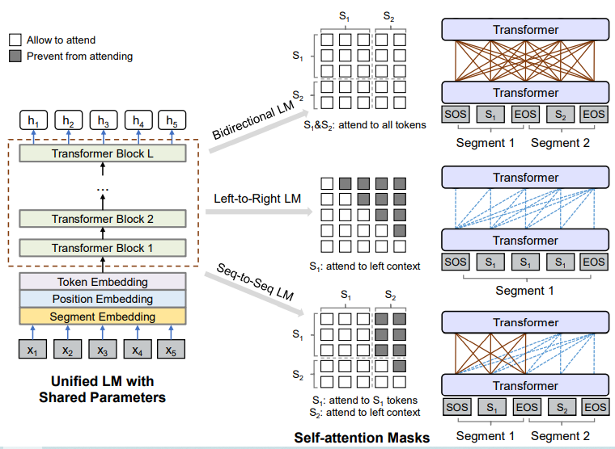
UNILM

Slide 22
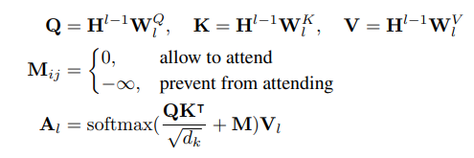
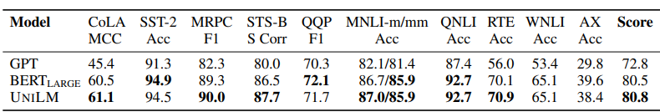
UNILM
依靠mask控制哪些词参与context embedding的计算

Slide 23
UNILM
We propose a unified pre-training model, UNILM, which is jointly optimized for several LM objectives with shared parameters. The unification of bidirectional, unidirectional, and sequence-to-sequence LMs enables us to straightforwardly fine-tune the pre-trained UNILM for both NLU and NLG tasks
解决了原生BERT在生成式任务上的短板

Slide 24
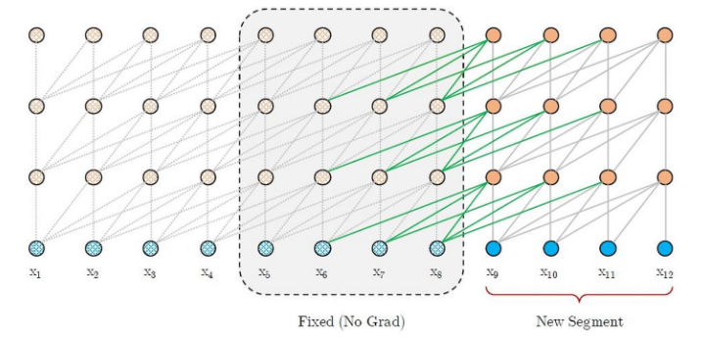
Transformer-XL & XLNet
希望解决Transformer的长度限制问题
1.循环机制 Recurrence Mechanism

Slide 25
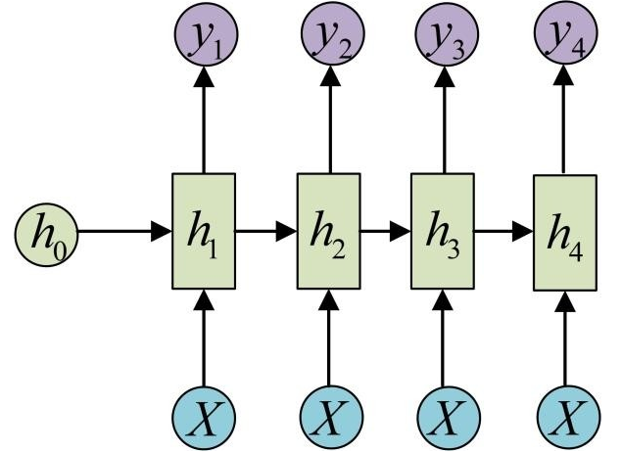
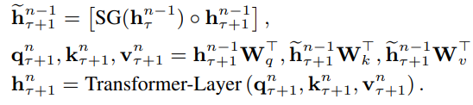
Transformer-XL & XLNet
回顾RNN机制
将隐单元向量不断向后传递
在Transformer中，将前一段文本
的隐向量与后一段文本印象里拼接
之后计算attention

Slide 26
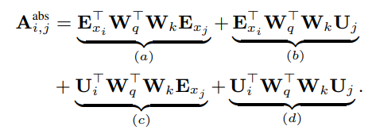
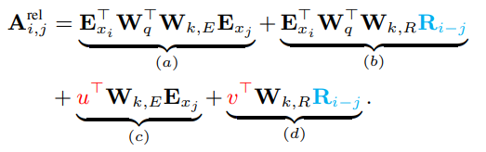
Transformer-XL & XLNet
2.相对位置编码 Relative Positional Encodings
(E_{xi}^{T} + U_{i}^{T})W_{q}^{T}W_{k}(E_{xj} + U_{j})
E = word embedding
U = position embedding
R_{i-j} non trainable
sinusoid encoding matrix
u, v trainable

Slide 27
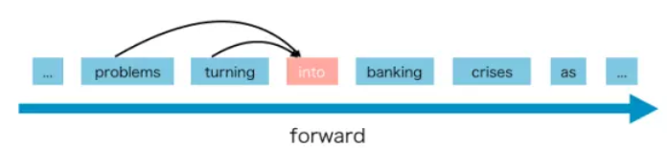
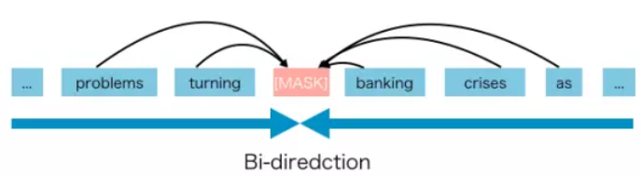
Transformer-XL & XLNet
AR语言模型 auto regressive language model
单向预测下一个字
缺点：缺少双向信息
AE语言模型 auto encoding language model
双向信息输入，预测中间某个mask的字
缺点：引入了[mask]，但实际任务中不不存在

Slide 28
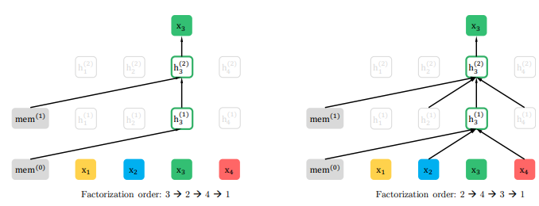
Transformer-XL & XLNet
AR语言模型与AE语言模型融合
Permutation Language Model
调整句子顺序，之后进行单向预测

Slide 29
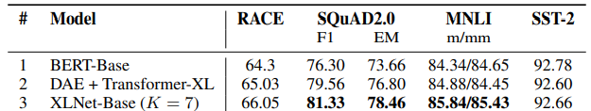
Transformer-XL & XLNet
XLNet is a generalized AR pre-training method that uses a permutation language modeling objective to combine the advantages of AR and AE methods
修改训练目标，同时修改模型结构，带来效果提升
MLM -> PLM transformer -> transformer-xl

Slide 30
Roberta
Robustly optimized BERT approach
模型结构不变，训练方式调整
1）更多的数据，更大的batch size，更久的训练
2）去掉next sentence prediction
3）使用更长的样本
4）动态改变mask位置

Slide 31
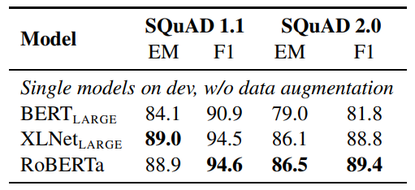
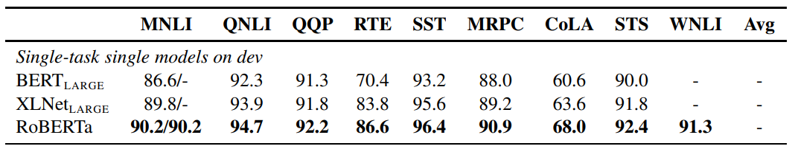
Roberta
We find that BERT was significantly undertrained, and can match or exceed the performance of every model published after it.

Slide 32
Roberta
These results illustrate the importance of these previously overlooked design decisions and suggest that BERT’s pre-training objective remains competitive with recently proposed alternatives.
挖掘旧的方法的潜力，有时比创新还要有效
能够最大限度的发挥一种算法的能力，是算法工程师能力的体现

Slide 33
SpanBert
与BERT的主要区别有三个：
1.去掉了NSP任务
2.随机mask几个连续的token
3.新的预训练任务SBO（Span Boundary Objective）

Slide 34
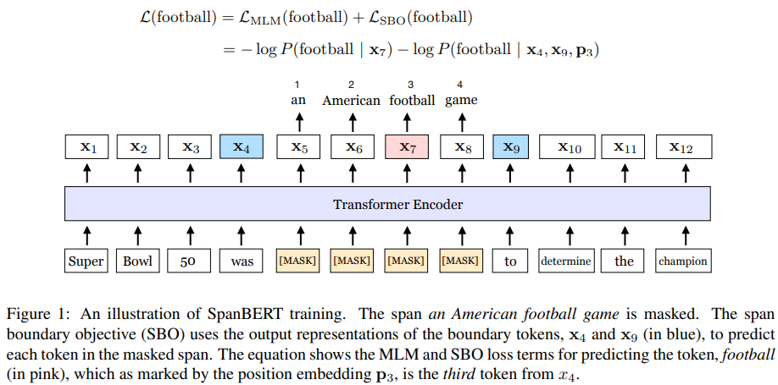
SpanBert

Slide 35

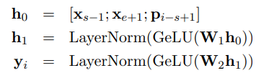
SpanBert
SBO任务
X_{s-1}代表mask片段之前的第一个token的Embedding
X_{e+1}代表mask片段之后的第一个token的Embedding
P_{i-s+1}代表目标token的Position Embedding
SBO预测层

Slide 36
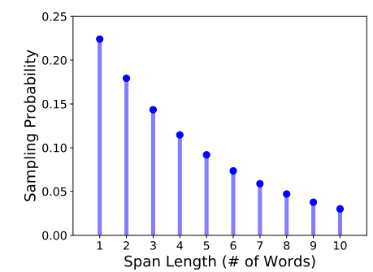


SpanBert
Mask片段长度采样分布
几何分布：

Slide 37
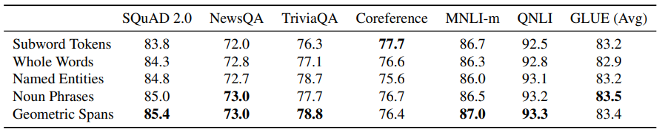
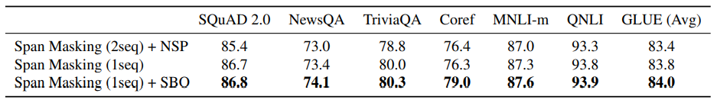
SpanBert
Mask指定实体或名词短语，效果不如mask随机片段
NSP作用不大，不如不加，不如SBO

Slide 38
SpanBert
While others show the benefits of adding more data and increasing model size, this work demonstrates the importance of designing good pre-training tasks and objectives, which can also have a remarkable impact.
大模型+更多的数据不是唯一出路，改变训练目标也有很大影响

Slide 39
ALBERT
试图解决Bert模型过大的问题
想办法减少参数量
1. Factorized embedding parameterization
Embedding层的因式分解
2. Cross-layer parameter sharing
跨层参数共享

Slide 40
ALBERT
Factorized embedding parameterization
O(V × H) -> O(V × E + E × H)
V = 词表大小 30000
H = 隐单元个数 1024
E = 指定Embedding大小 512 （原生Bert无此参数）
参数量
V x H = 30720000
V x E + E x H = 15360000 + 524288 = 15884288

Slide 41
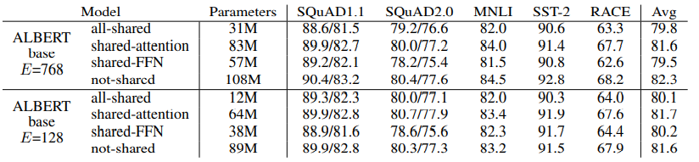
ALBERT
Cross-layer parameter sharing
跨层参数共享，有多种共享方式：
只共享attention部分
只共享feed-forward部分
全部共享

Slide 42
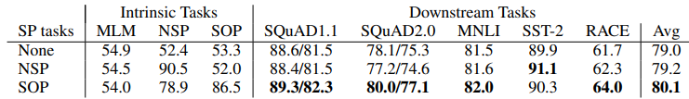
ALBERT
SOP任务替代NSP任务
Sentence order prediction
预测两句话的前后关系，同样是二分类任务
[CLS] 你好啊bert [SEP] 好久不见 [SEP] -> Positive
[CLS] 好久不见 [SEP]你好啊bert [SEP] -> Negative
论文认为NSP任务过于简单

Slide 43
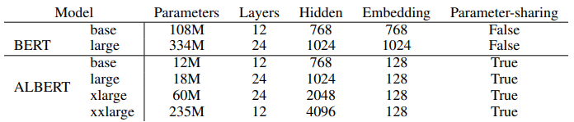
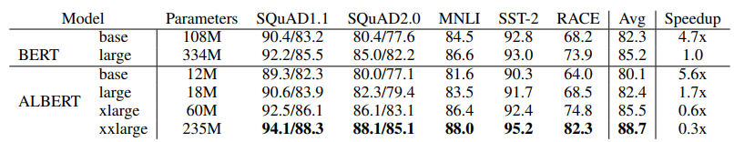
ALBERT
局限性：
1.虽然目的在于缩减参数，但依然是越大越好
2.虽然缩减了参数，但是前向计算速度没有提升（训练速度有提升）

Slide 44
ALBERT
Given the importance of model size, we ask: Is having better NLP models as easy as having larger models?
we are able to scale up to much larger ALBERT configurations that still have fewer parameters than BERT-large but achieve significantly better performance
工程角度讲价值不大，但是证明了参数量并非模型能力的绝对衡量标准

Slide 45
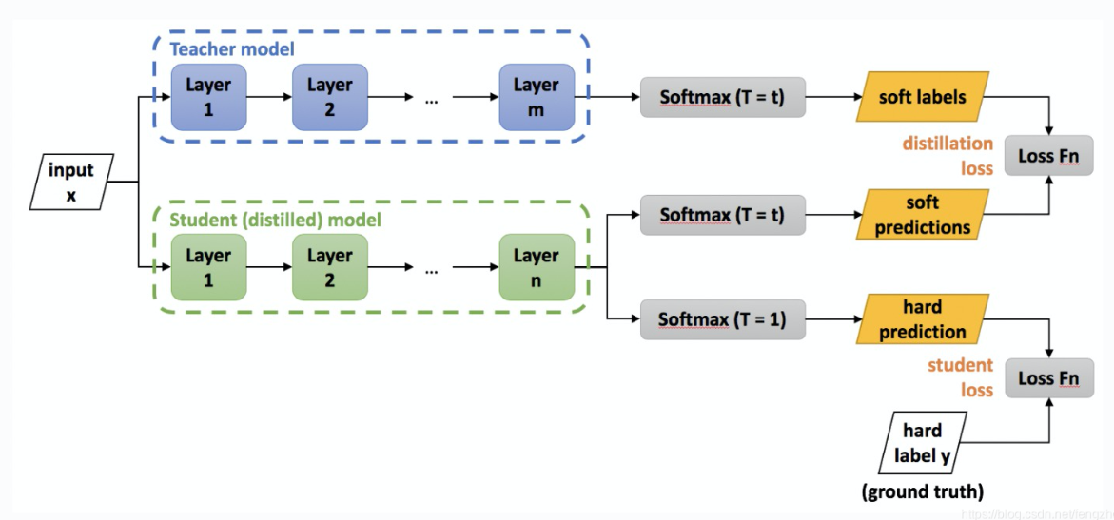
DistillBert 模型蒸馏技术
小模型从大模型输出的概率分布进行学习

Slide 46
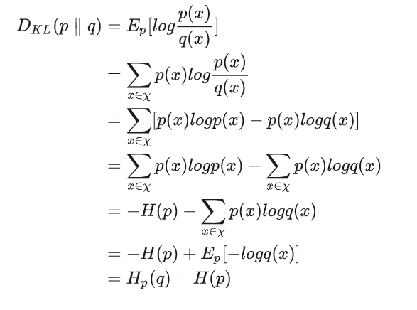

KL散度
KL散度是一种衡量两个概率分布（也可简单理解为向量）之间差异的算法。经常作为神经网络的loss函数使用。
与交叉熵计算过程实际非常接近，但交叉熵通常要求target是one-hot形式。
示例：
P = [0.2, 0.4, 0.4]
Q = [0.4, 0.2, 0.4]
公式：
KL散度与交叉熵的关系

Slide 47
DistillBert 模型蒸馏技术
小模型从大模型输出的概率分布进行学习
KL散度
交叉熵

Slide 48
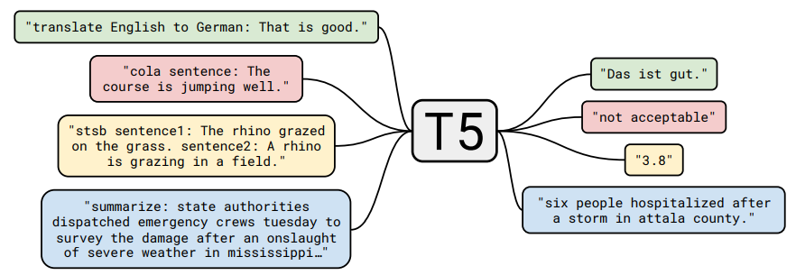
T5
Text-to-Text Transfer Transformer
Seq2seq理论上可以解决一切NLP问题
分类问题：文本 -> 标签
命名实体识别：文本 -> 实体
摘要、翻译：文本 -> 文本
回归问题：文本 -> 0.1(字符串)

Slide 49
T5
翻译
<Translation ZH-EN> 你 好 吗 -> How are you
摘要
<Summary> 原 文 本……. -> 摘 要 文 本…
分类
<Classification> A 股 市 场…. -> 金 融
通过自定义的token区分任务，共享模型和解码方式

Slide 50
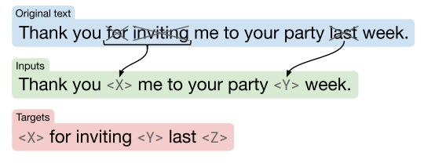
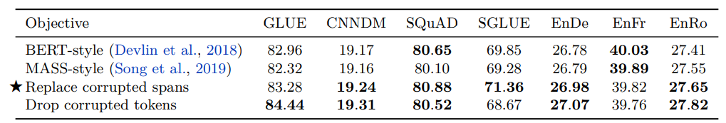
T5
预训练任务设计 text corruption

Slide 51
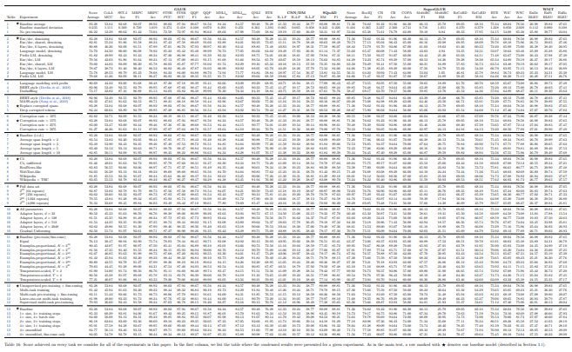
T5

Slide 52
T5
Our text-to-text framework provides a simple way to train a single model on a wide variety of text tasks using the same loss function and decoding procedure. We showed how this approach can be successfully applied to generative tasks like abstractive summarization, classification tasks like natural language inference, and even regression tasks like STS-B
迈向NLP的大一统

Slide 53
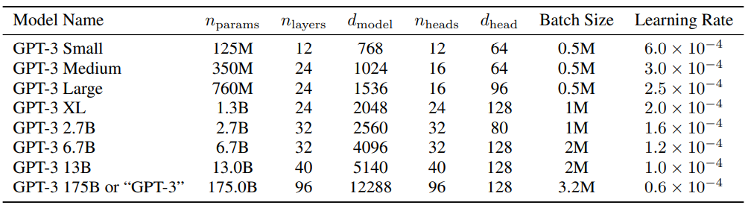
GPT3
1750 亿参数量，是GPT-2的116倍
模型结构与GPT-2相同
继续使用单向语言模型预训练

Slide 54
GPT3
Pre-training + fine-tune ×
理由：
1、fine-tune需要的数据，经常是缺失的
2、fine-tune会涉及对模型进行改造，使其变复杂，并失去泛化性
3、人类学习做新任务并不需要很多样本
Pre-training + Zero-, One-, Few-shot √

Slide 55
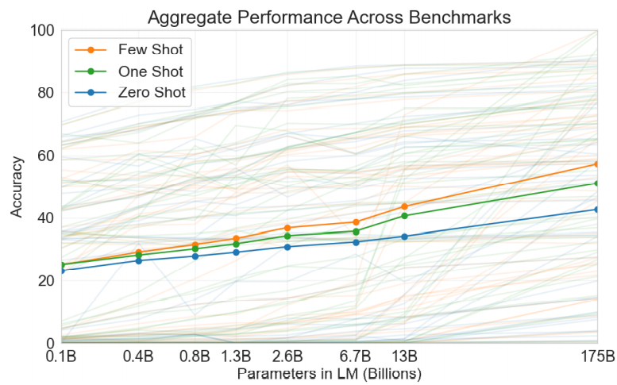
GPT3

Slide 56
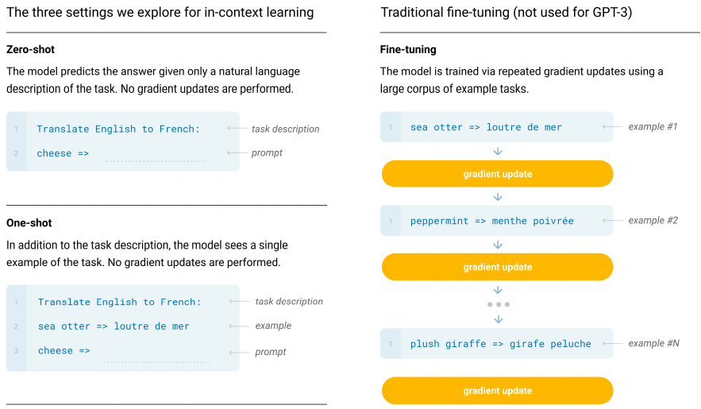
GPT3

Slide 57
GPT3
Aside from pointing to a conceptual limitation in our current NLP techniques, this adaptability has practical advantages – it allows humans to seamlessly mix together or switch between many tasks and skills, for example performing addition during a lengthy dialogue. To be broadly useful, we would someday like our NLP systems to have this same fluidity and generality.
人工智能的目标：像人一样的学习能力

Slide 58
Input: text
Output: label
你的名字是什么
Linear layer
BERT
0
使用bert类模型微调，需要一个随机初始化的线性层
这为使用带来了不便

Slide 59
Input: text
Output: text
文本形式输入问题
语言模型
文本形式回答
更加理想的方式，模型永远生成文本，用文本描述各种各种任务的答案
训练方式统一，推理方式统一
Notes:
A top-down approach to explain Instruction finetuning is that you frame tasks in the instruction and train the model on whole bunch of them and the model is much better.
Again I will take the bottom-up approach and try to derive up the core principle.

Slide 60
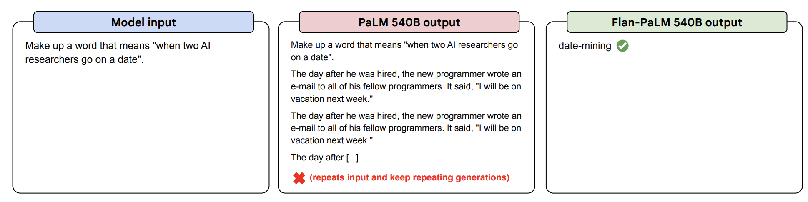
从“续写”到“回答”

Slide 61
InstructGPT
RLHF
Reward model training
Pretraining
Instruction finetuning
Policy model training

Slide 62
pretrain训练
input:length * embedding_dim
今 天 是 个 好 天 气
语言模型(lstm, bert, cnn...)
逐字计算交叉熵
天 是 个 好 天 气 <eos>
output:length * vocab_size

Slide 63
SFT训练
input:length * embedding_dim
你 好 吗 <sep> 我 很 好
语言模型(lstm, bert, cnn...)
逐字计算交叉熵
我 很 好 <eos>
output:length * vocab_size

Slide 64
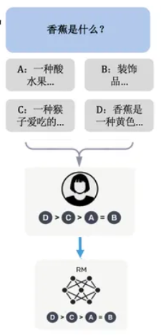
RW训练
对于一个输入问题，获取若干可能的答案
由人工进行排序打分
两两一组进行Reward Model训练
rθ是一个交互式文本匹配模型，输出为标量（0-1）
x : 问题（prompt）
y_{w} : 相对好的答案
y_{l} : 相对差的答案

Slide 65
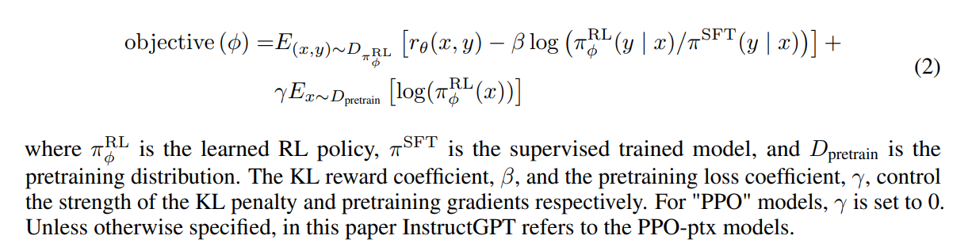
RL训练

Slide 66
Rule-based systems
Learnable part of the system
Input
Hand-designed program
Output

Slide 67
Rule-based systems
Learnable part of the system
Input
Hand-designed program
Output
Classical machine learning
Input
Hand-designed features
Mapping from features
Output
Hand- designed
loss function

Slide 68
Rule-based systems
Learnable part of the system
Input
Hand-designed program
Output
Classical machine learning
Input
Hand-designed features
Mapping from features
Output
Hand- designed
loss function
Deep learning: (self-)supervised learning
Input
Learned
features
Mapping from features
Output
Hand- designed
loss function

Slide 69
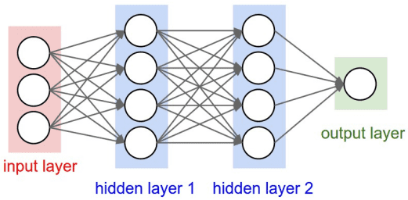
Rule-based systems
Learnable part of the system
Input
Hand-designed program
Output
Classical machine learning
logistic regression
Input
Hand-designed features
Mapping from features
Output
Hand- designed
loss function
Deep learning: (self-)supervised learning
Feedforward neural net
Input
Learned
features
Mapping from features
Output
Hand- designed
loss function

Slide 70
Rule-based systems
Learnable part of the system
Input
Hand-designed program
Output
Classical machine learning
logistic regression
Input
Hand-designed features
Mapping from features
Output
Hand- designed
loss function
Deep learning: (self-)supervised learning
Feedforward neural net
Input
Learned
features
Mapping from features
Output
Hand- designed
loss function
Deep learning: other RL formulations
Input
Learned
features
Mapping from features
Output
Learned
loss function

